Slide 1

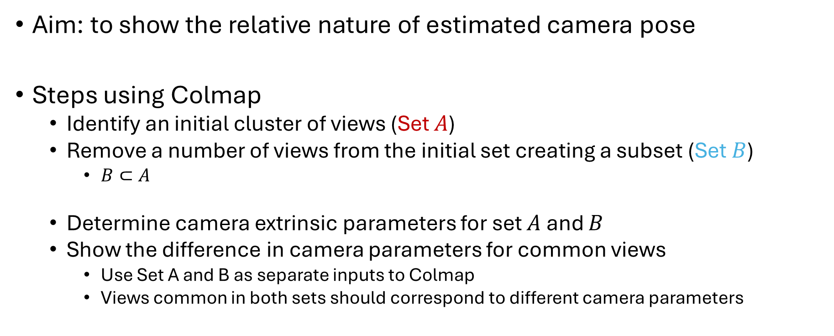

Camera Extrinsic Parameters: Test 1
Aim: to show the relative nature of estimated camera pose
Steps using Colmap
Identify an initial cluster of views (Set $A$)
Remove a number of views from the initial set creating a subset (Set $B$)
$B⊂A$
Determine camera extrinsic parameters for set $A$ and $B$
Show the difference in camera parameters for common views
Use Set A and B as separate inputs to Colmap
Views common in both sets should correspond to different camera parameters
Set $A$
Set $B$

Slide 2
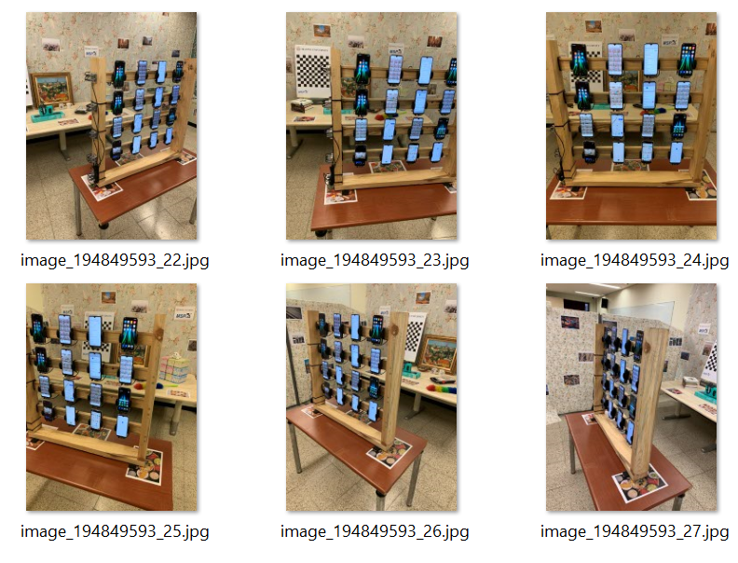
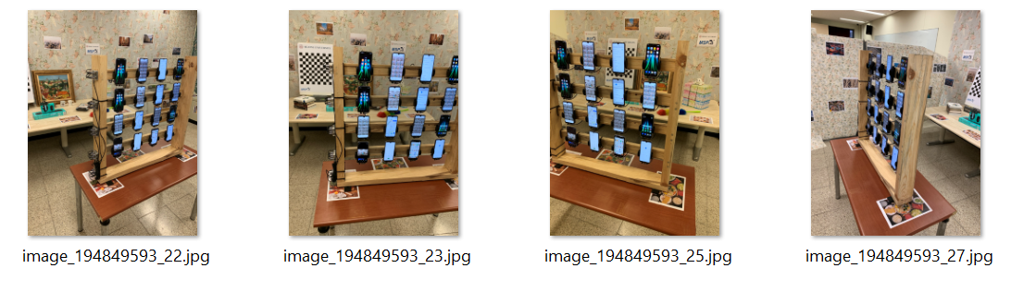
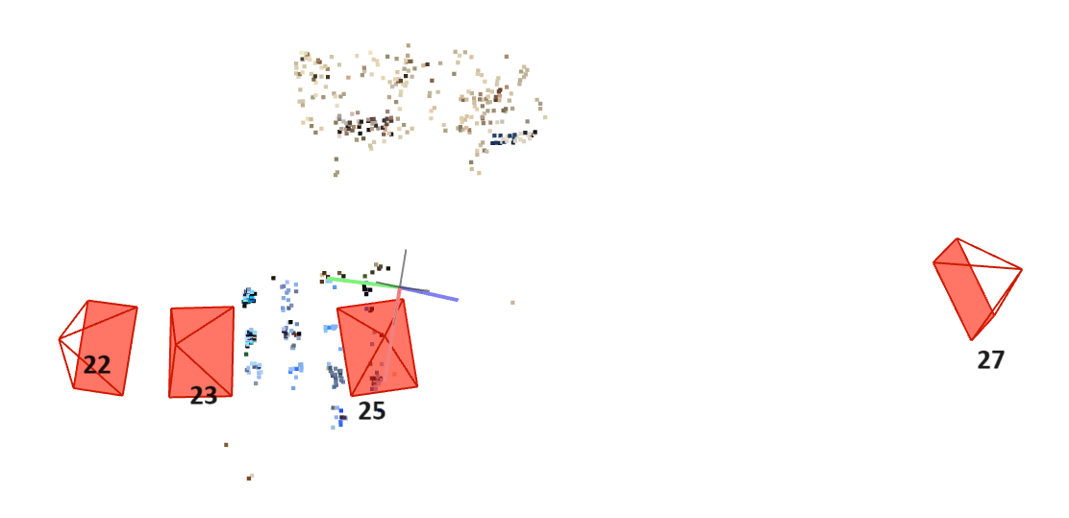
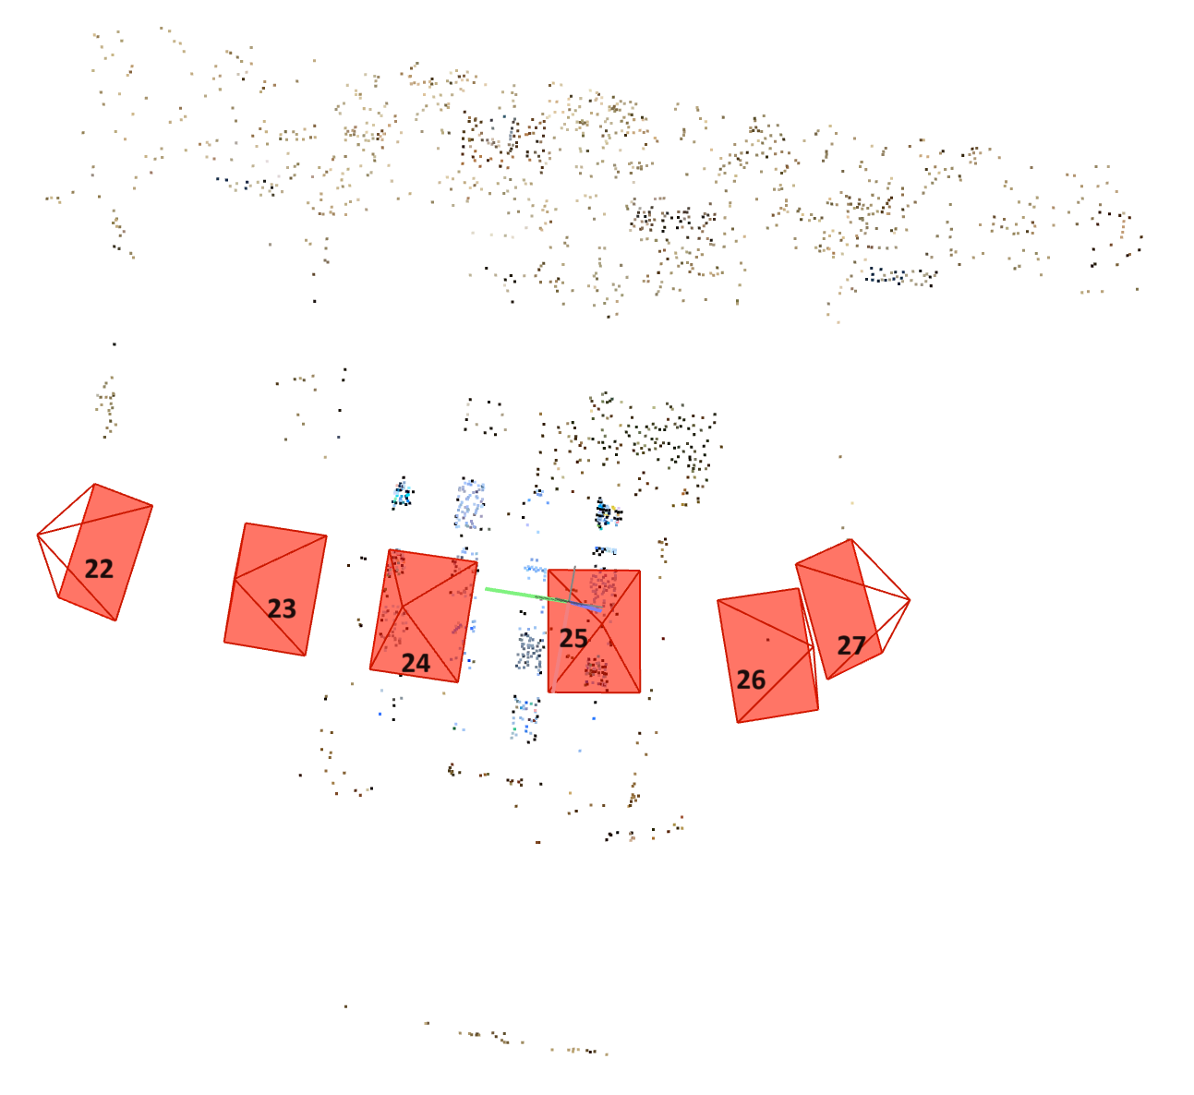
Set B
Set A

Slide 3
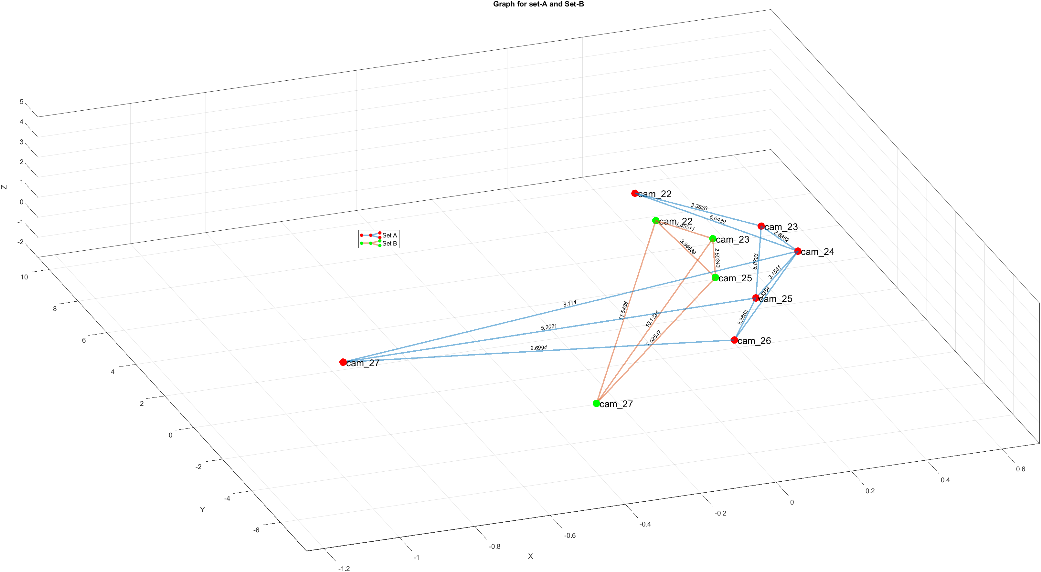

Slide 4

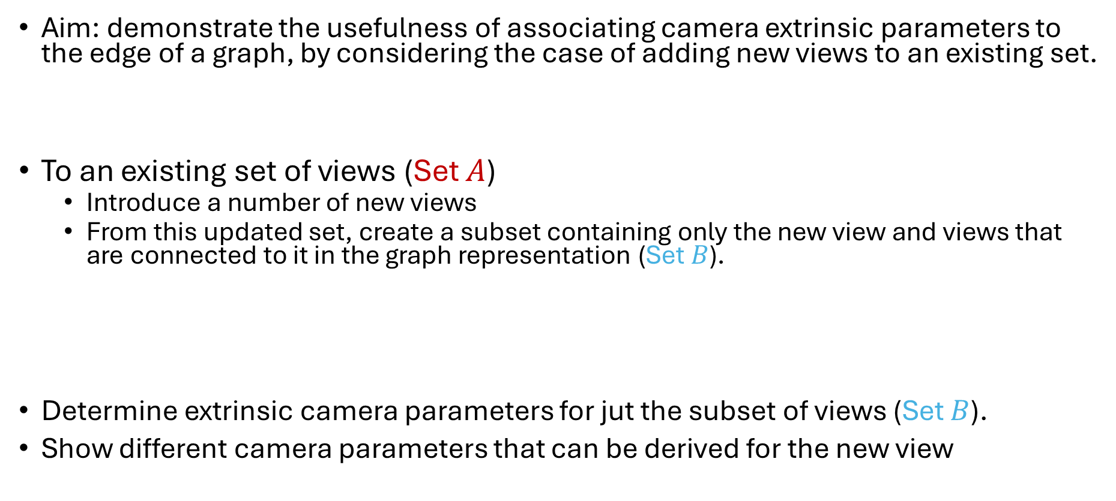


Camera Extrinsic Parameters: Test 2
Aim: demonstrate the usefulness of associating camera extrinsic parameters to the edge of a graph, by considering the case of adding new views to an existing set.
To an existing set of views (Set $A$)
Introduce a number of new views
From this updated set, create a subset containing only the new view and views that are connected to it in the graph representation (Set $B$).
Determine extrinsic camera parameters for jut the subset of views (Set $B$).
Show different camera parameters that can be derived for the new view
Set $A$
New view
Set $A$
Set $B$

Slide 5
Point cloud for pairs of views: Test 3
Aim: to associate a sparse set of point clouds with a pair of views.
Using Colmap or Matlab, determine point clouds for a pair of views.
Resulting sparse point clouds can be associated with edges between pairs of views in the graph.
Allows sparse point clods to be stored as an initial description of parts of the scene.
Extend to determining point clouds for a small set of views (e.g. 4 views)
Use Colmap to create a point cloud for the small set of views
Explore options for associating subsets of point clouds with edges between view pairs.

